Slide 1
Practical Federation
Jamie Lennox
Senior Software Engineer, Red Hat
31/07/2015
Notes:
Hi everyone.
My name is Jamie Lennox, I'm a senior software engineer at Red Hat
I've also been a core member of the keystone team for about 18 months and in that time federated identity has been one of the key advancements in keystone and OpenStack in general
It's also been talked about a lot over that period, including this time last year where I gave an overview.
This means if you are interested in federated identity you have probably seen at least one talk on it and waded through a few blog posts.
This year I was asked to do something a little more technical and indepth than what people might already have seen, so we are going to live dangerously and do a live walk through of the steps to setting up websso in keystone and horizon.
We can check out some of the warts and hopefully explain the purpose of all the options you have to set to make this work.

Slide 2
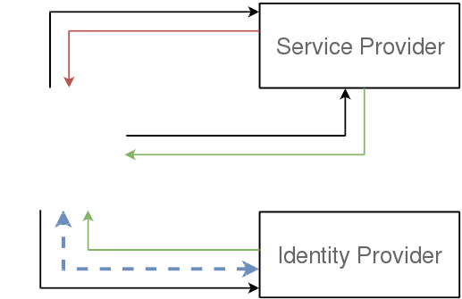

Saml WebSSO
Notes:
Because of this goal I'm not going to do an explanation of all possible protocols, they are well covered online, and at a high level involve managing your user credentials in a single external location, so you never give secrets to the service provider.
SAML is the most mature of these protocols in keystone mostly because it's used in big enterprise deployments and was therefore what we targetted first but other protocols will work in a similar way.
The high level flow of websso authentication is fairly easy. We have two entities, the service provider is the server we are trying to access a resource from and the identity provider is the server who knows who we are and that we have to authenticate with.
We ask the service provider for a resource, and because we aren't authenticated yet get denied and our browser gets redirected to the identity provider where we need to log in. After logging in we get back an assertion of all the things the idp knows about the user which is sent with the next request to the service provider. The service provider can use this assertion to determine what the user should have access to.

Slide 3
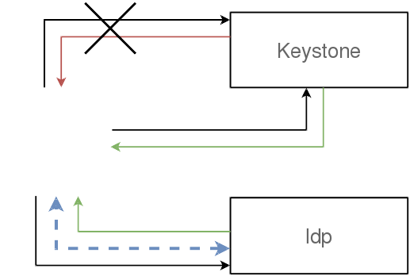
It's not that simple...
Notes:
In openstack this is not so simple beacuse we've got seperate services for all these things so the service provider in this case would be keystone. But keystone doesn't have web pages or fancy login forms. Nor do we want to teach horizon how to deal with different authentication responses.
In previous talks we've discussed non-interactive federated authentication to keystone, on a command line for example. In this case we're specifically discussing web single sign on (SSO) with redirects and graphical logins so we need to figure out how to put both horizon and keystone into the mix.

Slide 4
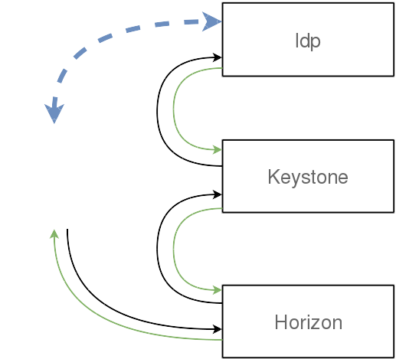
Adding Keystone
Notes:
So from a very high level we need to have our browsers go to horizon, then get redirected to keystone which handles the authentication with the external idp and keystone will send you back to horizon.
Having this pattern means that keystone is still the authentication service in OpenStack. Horizon will not know details of the Idp, nor will the idp know about keystone.
I need to note that this is a web exchange. Each of those looping connectors drawn there I've tried to use to represent a redirect. So keystone never directly communicates with the IDP or horizon, this all goes via the browser.

Slide 5
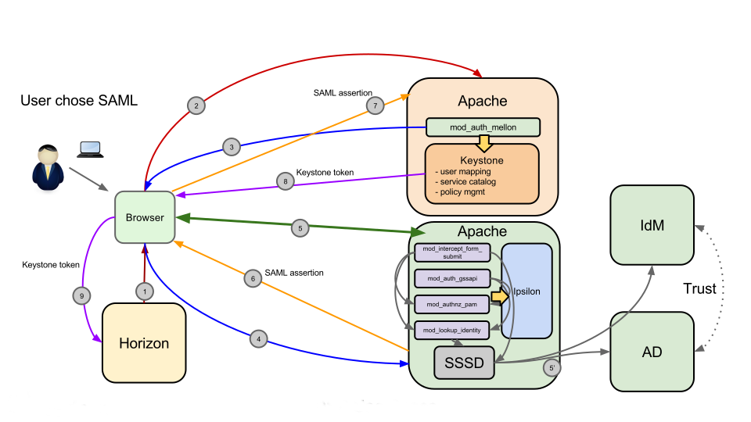
Or more accurately...
Notes:
In reality it's a much more complex picture. This is a real diagram I stole from my manager explaining the interaction that we are going to set up today.
But the basic flow we need to establish is
horizon to keystone,
keystone to IDP ,
IDP returns assertion,
Keystone turns assertion into token
Keystone returns token to horizon,
Business as usual.

Slide 6
Ipsilon
Universal Adapter of Identity Providers
  Frontend: SAML
  Backend: SSSD, PAM
  Authentication: Password, Kerberos
1.0.0 Released on 2015-05-12
https://fedorahosted.org/ipsilon/
Notes:
For our SAML provider we are going to be using ipsilon. It's a relatively new project whose goal is be a standalone SSO front end to existing or older identity providers.
It can take identity information from a couple of sources, like SSSD or from PAM at the moment and there are others coming.
Provide a number of authentication options depending on the available backend.
It can then provide federated login to that identity source without having modified the original provider. At the moment the federated protocol is SAML but there is the intent to add OpenID connect and others in the future.
It's going to be available with RHEL 7.2 which I think is due later this year, but it's all packaged and usable on fedora already.

Slide 7
Demo
Kilo
Nova, Glance, Cinder, Keystone, nova-network
V3 Identity everywhere
FreeIPA, Ipsilon
github.com/jamielennox/pyconau2015-ansible/
  does rely on some non-public nightly repos
Notes:
For the sake of simplicity I've got two virtual machines set up on this laptop. One is running FreeIPA and the ipsilon provider. The other is running openstack deployed via packstack.
It's running the most basic realistic OpenStack configuration possible as the laptop is not all that powerful.
I've converted the deployment to use v3 authentication everywhere. This is important for any federated use case as it's not supported by the v2 apis. This includes validating tokens, so the nova user has to be doing v3 authentication.
I've got a link there to my ansible scripts I was using to create reproducable builds, also in there are the notes I had with the hacks I've had to do to ensure the correct builds of everything. This should all be fixed up by the time rhel 7.2 gets released.
The reason I'm doing this on pre released rhel 7.2 is to get supported ipsilon packages. There's nothing I've done that is in any way private.

Slide 8

Source: http://thumbpress.com/dude-hold-my-beer-and-watch-this-15-pics/
Notes:
Show existing horizon deployment.
Show existing FreeIPA setup.

Slide 9
Steps
Configure horizon to use websso
Configure keystone to accept SAML websso
Create the identity provider in keystone
  Keystone uses a single websso entry point (per protocol)
  Must link between the IDP and SAML provider URL
Set up the openstack groups and roles
Map properties from Idp into keystone
Notes:
I'm going to try and do this in the steps that authentication is flowing. It's not the most efficient way, but I'm hoping it demostrates the flow.
The important distinction between websso and the CLI login is that keystone only supports one entry point for websso.
If you are familiar with federated CLI login you will know that your authentication URL is relative to your identity provider. In WebSSO there is only one configured route. If you want to support multiple WebSSO providers then you need to configure mod_auth_mellon or mod_shib to present a discovery page.

Slide 10
Takeaways
It's not trivial, but it's not that hard
Take care with your mappings
WebSSO is configured differently to CLI federation
Notes:
So I don't have much to add after that. The process can be fiddly, there are a number of config options and settings in keystone that need to be configured, however I don't think it's needlessly difficulty. There's a good reason you have to set each step.
Once you have the environment configured the mappings is going to be the difficult spot. Try and keep it obvious.
If you have already set up federated CLI login, then that's great as you have some experience dealing with federated apache configuration, you can reuse your keystone mapping and all of the groups, you can reuse the relationship with the IDP, however there is only one webSSO entry point in keystone and you will need to configure this independantly of the existing federated setup.

Slide 11
Questions?
jamielennox on freenode
jamielennox@redhat.com
@jamielennox_

